Slide 1
Searching for Gravitational Waves from Compact Binary Coalescence using LIGO and Virgo Data
Collin Capano
Ph.D. Defense
26 August 2011
Syracuse University

Slide 2
Outline
Physics of gravitational waves & detection
The LIGO and Virgo Interferometers
The CBC pipeline
S5 Results
S6 Results
Looking Forward

Slide 3
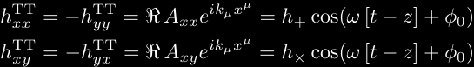
Physics of GWs
General Relativity predicts the emission of gravitational waves (GWs) from a changing mass quadrupole (or higher moment)
Two polarizations to the gravitational wave:

Slide 4

Physics of GWs

Slide 5
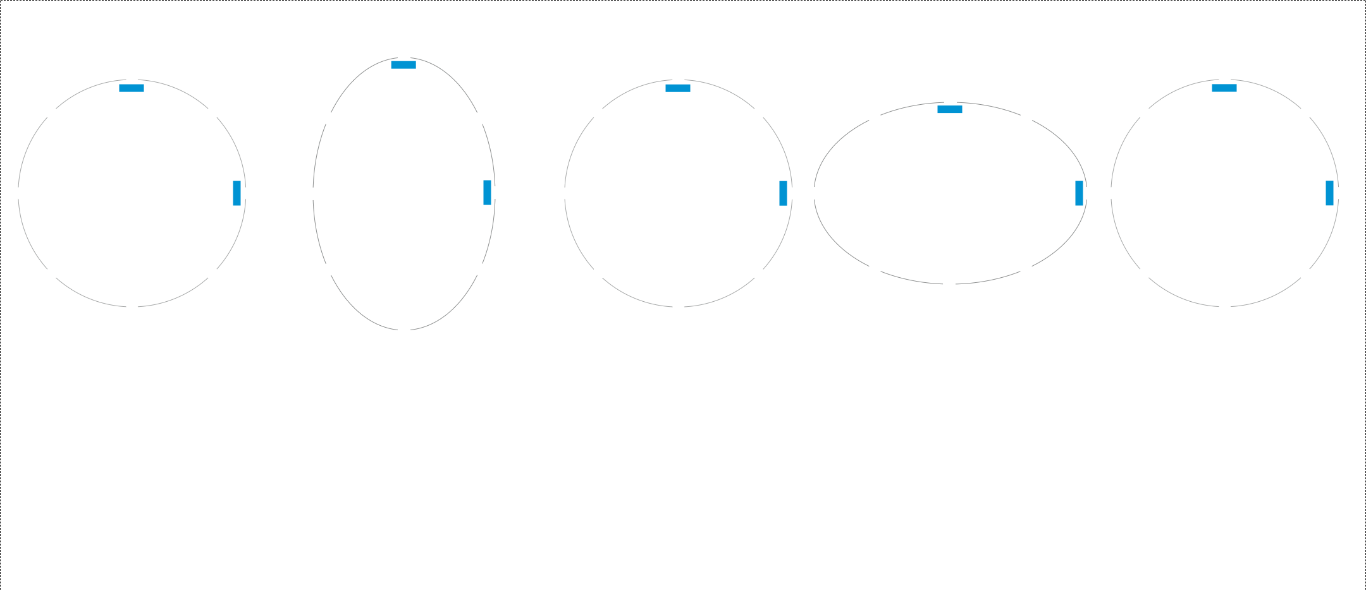
Detecting a GW

Slide 6
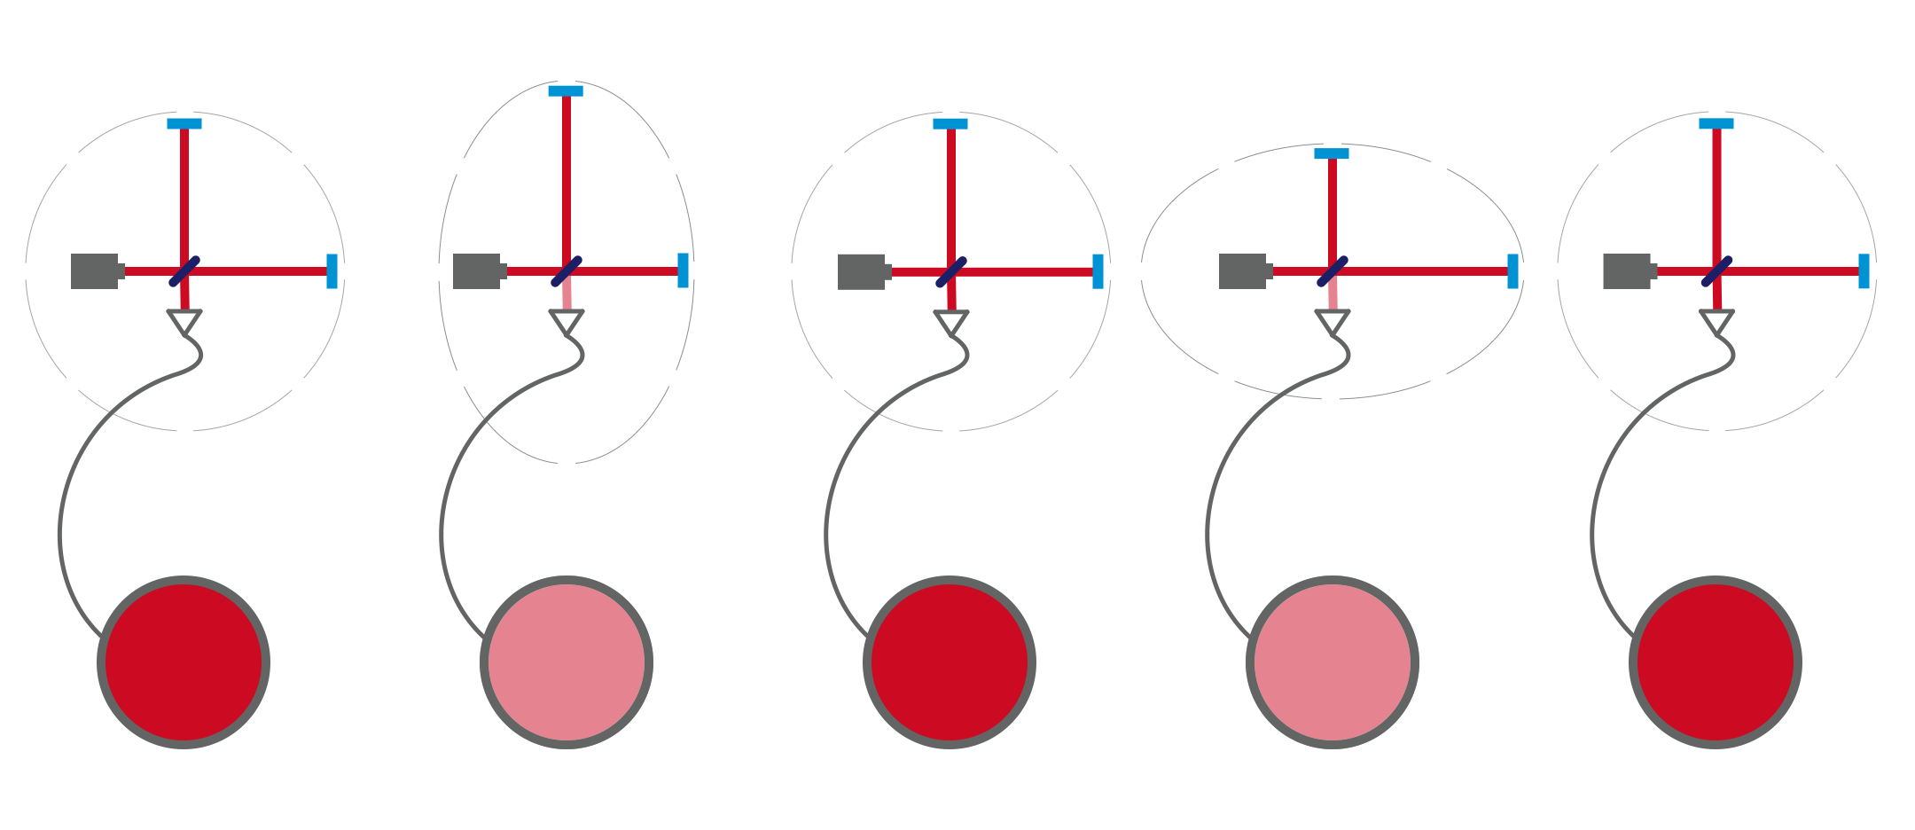
Detecting a GW

Slide 7
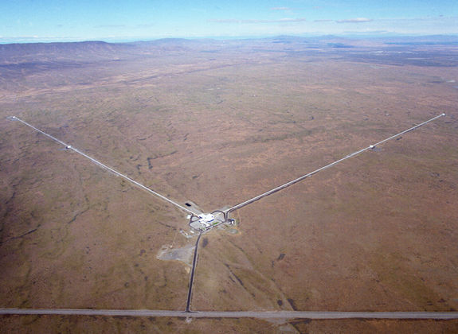
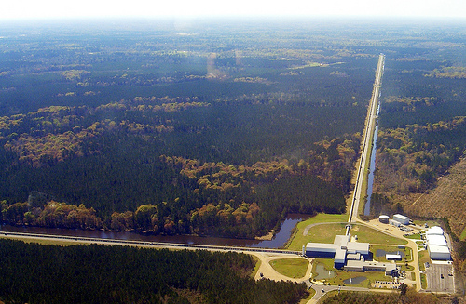
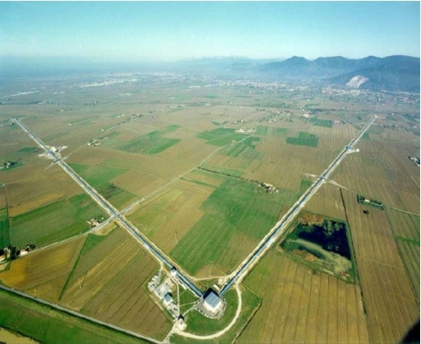
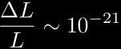
LIGO and Virgo
LIGO
4km and 2km at Hanford, WA
4km at Livingston, LA
Virgo
3km at Cascina, Italy

Slide 8
The LIGO & Virgo Science Runs
LIGO: Six Science Runs to date
Fifth Science Run (S5): November 2005 – September 2007
Sixth Science Run (S6): 7 July 2009 – 20 October 2010
Virgo: Three Science Runs to date
First Science Run (VSR1): May 2007 – October 2007
Second Science Run (VSR2): 7 July 2009 – 11 January 2010
Third Science Run (VSR3): 11 August 2010 – 20 October 2010

Slide 9
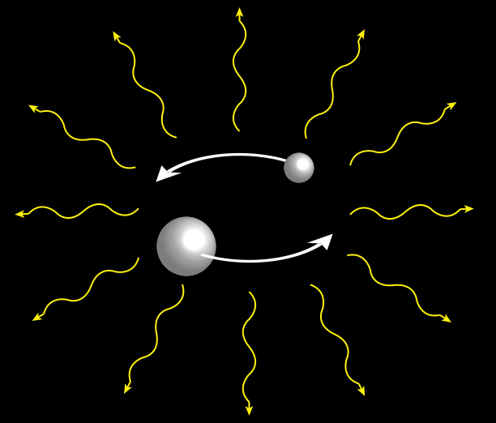
The CBC Group
The compact binary coalescence (CBC) group

Slide 10
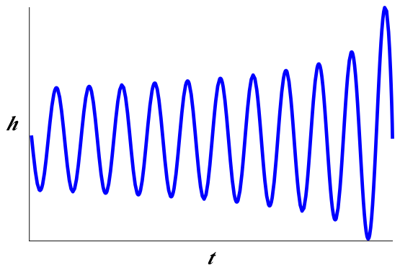
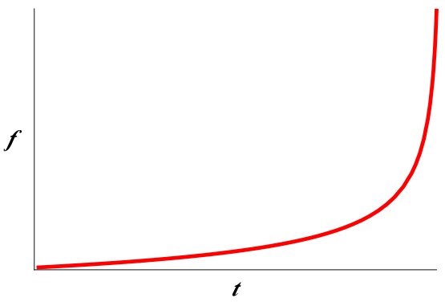
GWs from CBCs
Can model the “inspiral” part of the evolution using the post-Newtonian (pN) approximation

Slide 11
The CBC Group
All-sky searches
“Low Mass”
2M ≤ M_{TOTAL} ≤ 35M (with M_{COMP} ≥ 1M)
“High Mass”
25M ≤ M_{TOTAL} ≤ 100M
Triggered searches using GRBs
“Low-latency” all-sky searches with EM follow-up

Slide 12
The CBC Group
All-sky searches
“Low Mass”
2M ≤ M_{TOTAL} ≤ 35M (with M_{COMP} ≥ 1M)
“High Mass”
25M ≤ M_{TOTAL} ≤ 100M
Triggered searches using GRBs
“Low-latency” all-sky searches with EM follow-up

Slide 13
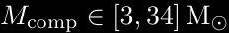
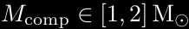
Astrophysical Sources of CBCs
Binary Neutron Stars (BNS)
Binary Black Holes (BBH)
Neutron Star – Black Hole Binaries (NSBH)

Slide 14
Astrophysical Sources of CBCs
Estimated Rates
Source
BNS | 0.01 | 1 | 10
NSBH | 6 × 10⁻⁴ | 0.03 | 1
BBH | 1 × 10⁻⁴ | 0.005 | 0.3
J. Abadie et al. Class. Quantum Grav.27:173001, 2010.

Slide 15
The CBC Search Pipeline

Slide 16
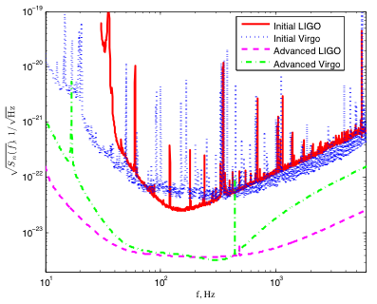
LIGO and Virgo Noise Curve
J. Abadie et al. Class. Quantum Grav.27:173001, 2010.

Slide 17
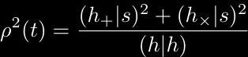
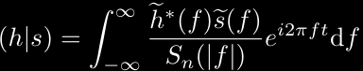
The Matched Filter
We construct an SNR time series:
Where the inner product is:
arXiv:gr-qc/0509116

Slide 18
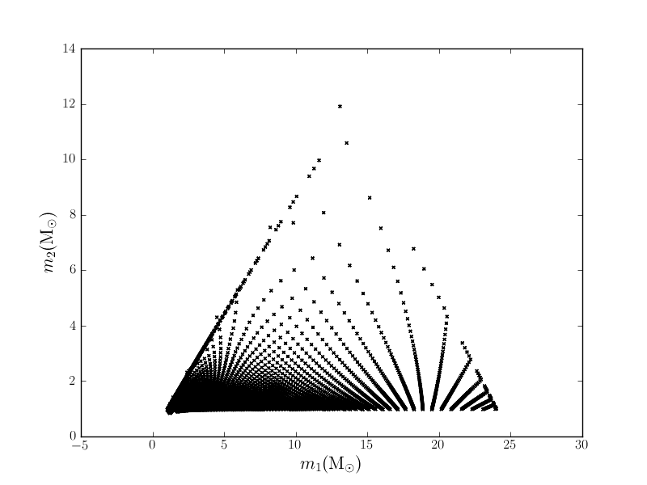
Template Bank

Slide 19
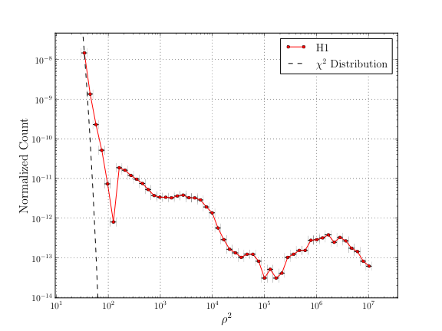
Non-Gaussian Transients

Slide 20
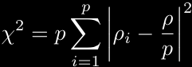
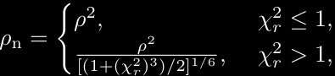
The χ² Test
We define the χ² test as¹:
Re-weight SNRs to give “New SNR”²:
B Allen. Phys. Rev. D 71:062001, 2005.
J Abadie et al. In preparation, 2011

Slide 21
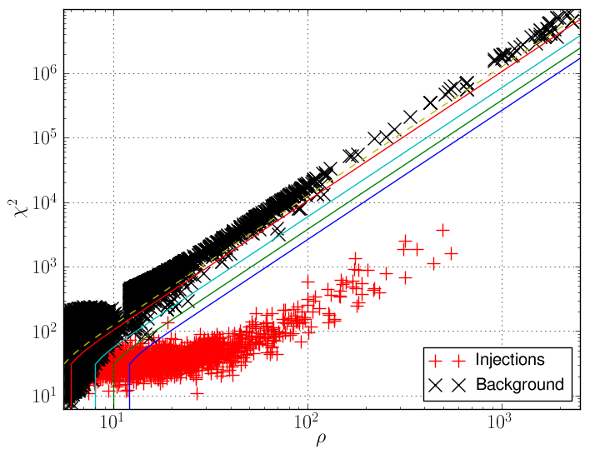
The χ² Test

Slide 22
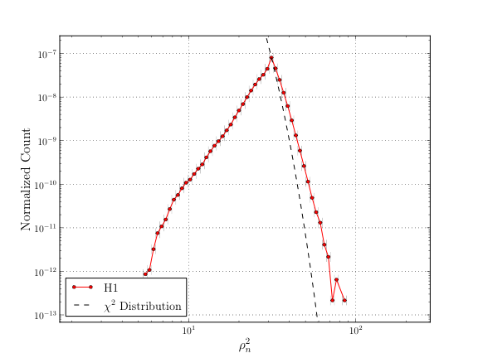
The χ² Test

Slide 23
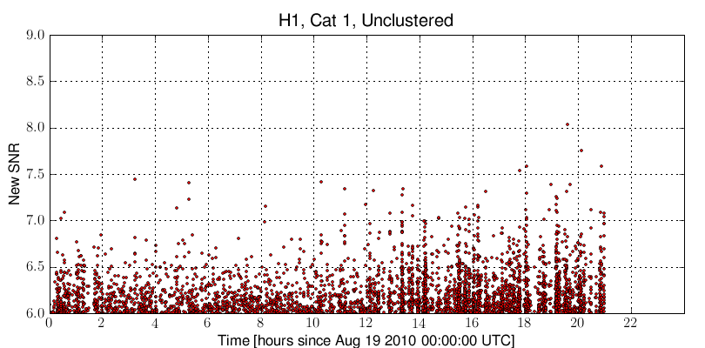
Vetoes
Look for correlations to environmental channels; if strong correlation, remove time
Pre-veto

Slide 24
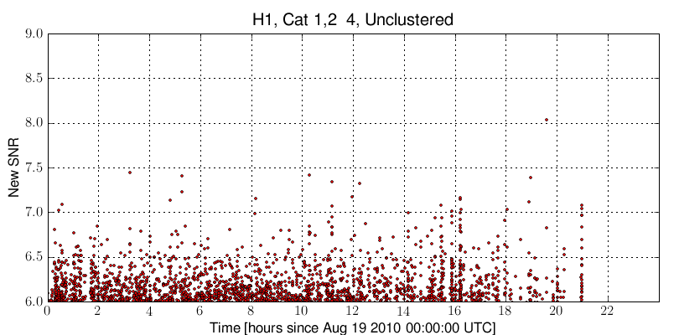
Vetoes
Look for correlations to environmental channels; if strong correlation, remove time
Vetoes Applied

Slide 25
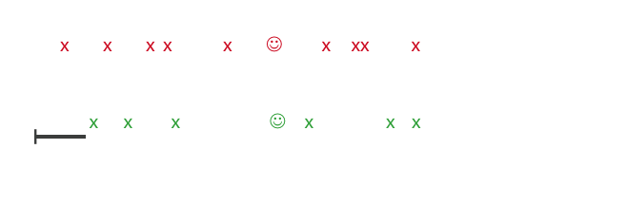
Coincidence Test
Expect GWs to be only correlated source across detectors
Demand triggers to be coincident in time and mass

Slide 26
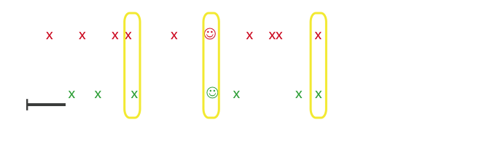
Coincidence Test
Expect GWs to be only correlated source across detectors
Demand triggers to be coincident in time and mass

Slide 27
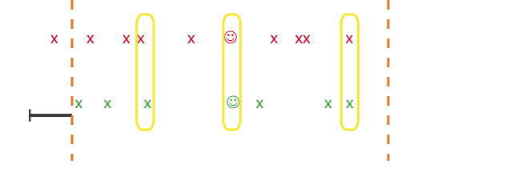
Coincidence Test
Expect GWs to be only correlated source across detectors
Demand triggers to be coincident in time and mass

Slide 28
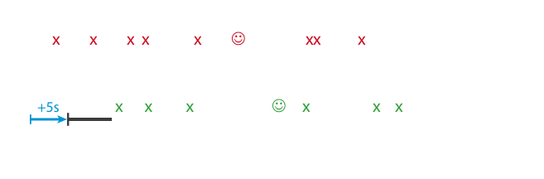
Time Slides
Need to estimate background rate
Slide detector data in time > light travel time between interferometer sites

Slide 29
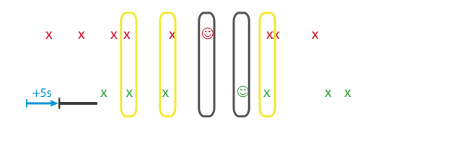
Time Slides
Need to estimate background rate
Slide detector data in time > light travel time between interferometer sites

Slide 30
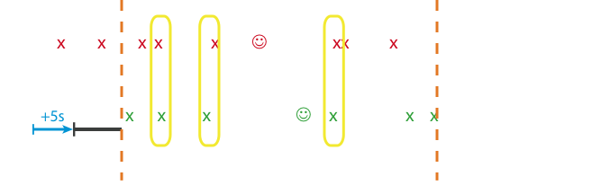
Time Slides
Need to estimate background rate
Slide detector data in time > light travel time between interferometer sites

Slide 31
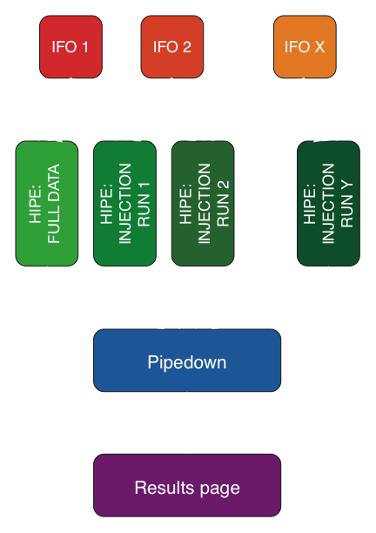
Overview

Slide 32
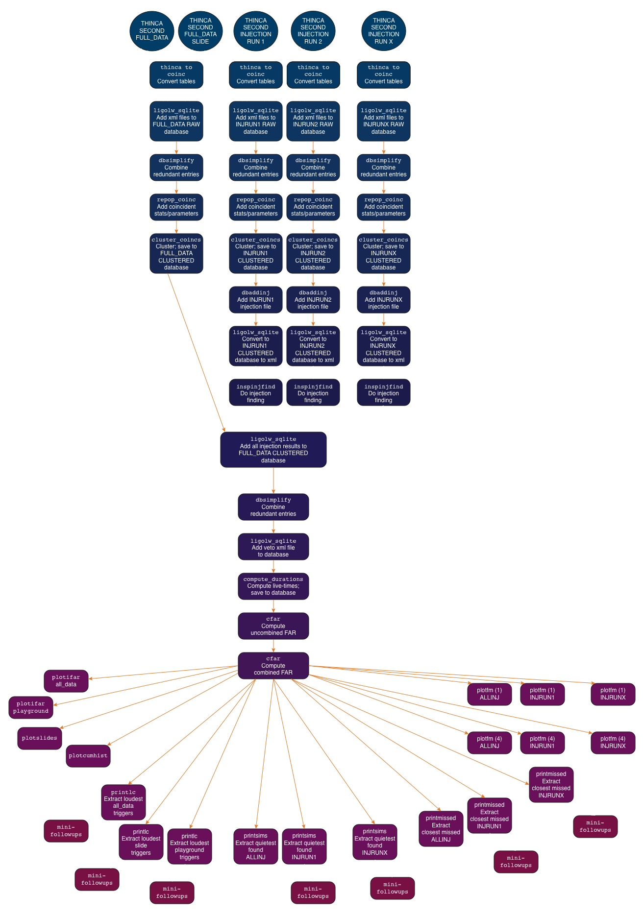
Pipedown

Slide 33
Pipedown
Calculate coincident statistics
Compute false alarm rates
Perform “injection” finding
Produce plots and lists of loudest triggers

Slide 34
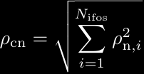
Pipedown
Calculate coincident statistics
Compute false alarm rates
Perform “injection” finding
Produce plots and lists of loudest triggers

Slide 35
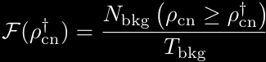
Pipedown
Calculate coincident statistics
Compute false alarm rates
Perform “injection” finding
Produce plots and lists of loudest triggers

Slide 36
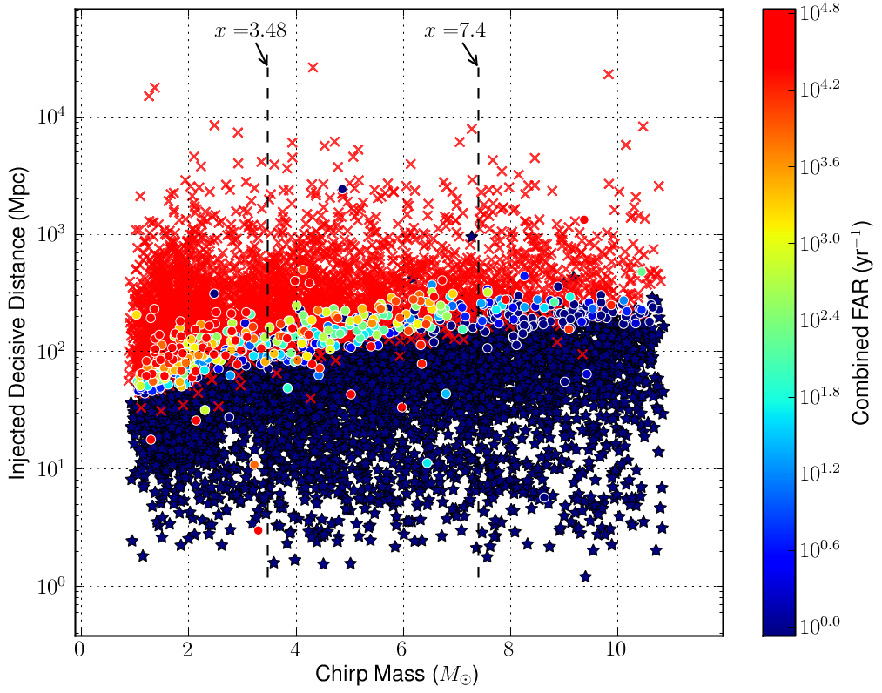
Pipedown
Calculate coincident statistics
Compute false alarm rates
Perform “injection” finding
Produce plots and lists of loudest triggers

Slide 37
Pipedown

Slide 38
Pipedown
Calculate coincident statistics
Compute false alarm rates
Perform “injection” finding
Produce plots and lists of loudest triggers

Slide 39
S5 Analysis

Slide 40
S5 and VSR1
S5 broken into three analyses
S5 first year¹: November 2005 – November 2006
S5 12-18 month²: November 2006 – May 2007
Joint LIGO/Virgo search³: May – October 2007
4km and 2km Hanford (H1 and H2), 4km Livingston (L1), and 3km Virgo (V1) used
S5 first year and 12-18 month used similar pipeline; modified for LIGO/Virgo search
1. B. Abbott et al. Phys. Rev. D, 79:122001, 2009.
2. B. Abbott, …, C. Capano, et al. Phys. Rev. D, 80:047101, 2009.
3. J. Abadie et al. Phys. Rev. D, 82:102001, 2010.

Slide 41
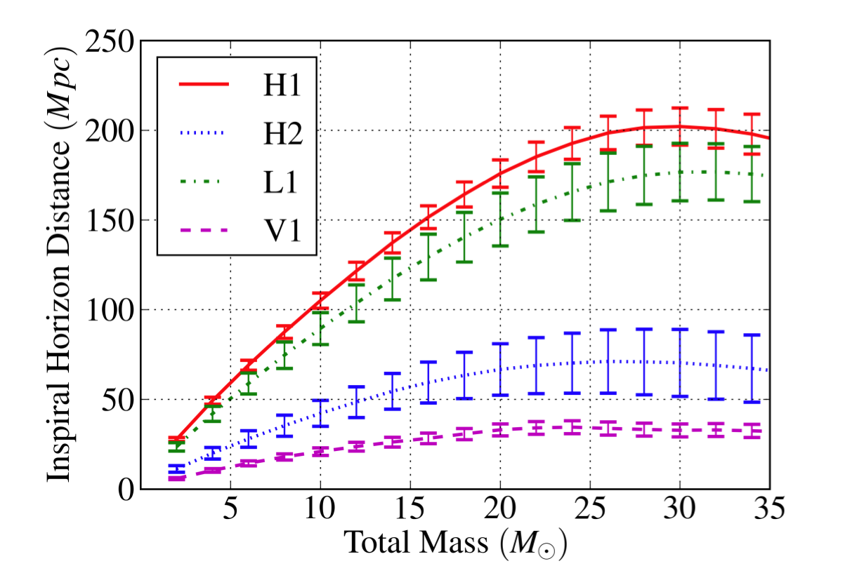
Analyzed time & Sensitivity
Total analyzed time was ~0.9 years
LIGO reached design sensitivity
J. Abadie et al. Phys. Rev. D, 82:102001, 2010.

Slide 42
Results
No gravitational waves were detected
Upper limits on BNS, NSBH, and BBH coalescence placed by combining results with earlier analyses

Slide 43
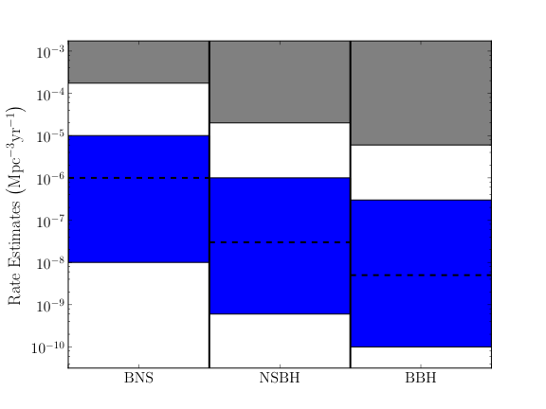
Upper Limits
Excluded Region

Slide 44
S6 Analysis

Slide 45
Analysis Periods
S6 and VSR2/3 jointly analyzed
S6/VSR2/3 broken up into 4 analysis periods
“A”: July 7, 2009 - Sept. 1, 2009
“B”: Sept. 24, 2009 - Jan. 11, 2010
End VSR2
“C”: Feb. 6, 2010 - June 25, 2010
LIGO only
“D”: June 26, 2010 - Oct. 20, 2010
VSR3 started August 11, 2010

Slide 46
Changes from initial LIGO/Virgo
LIGO
More powerful laser installed
Advanced LIGO prototypes
No H2
Virgo
Increased laser power
Thermal compensation system added
Scattered light mitigation
Monolithic suspension (VSR3)

Slide 47
Changes from initial LIGO/Virgo
Used 3.5pN order SPA templates
2.0pN used in S5
New SNR implemented
Improvement over “effective” SNR used in S5

Slide 48
Changes from initial LIGO/Virgo
Increased collaboration between data analysts and instrumentalists
Lower latency results
S5: had initial results 1-2 yrs after data taken
S6: had initial results within weeks of taking data
Were able to fine-tune data quality for CBC search

Slide 49
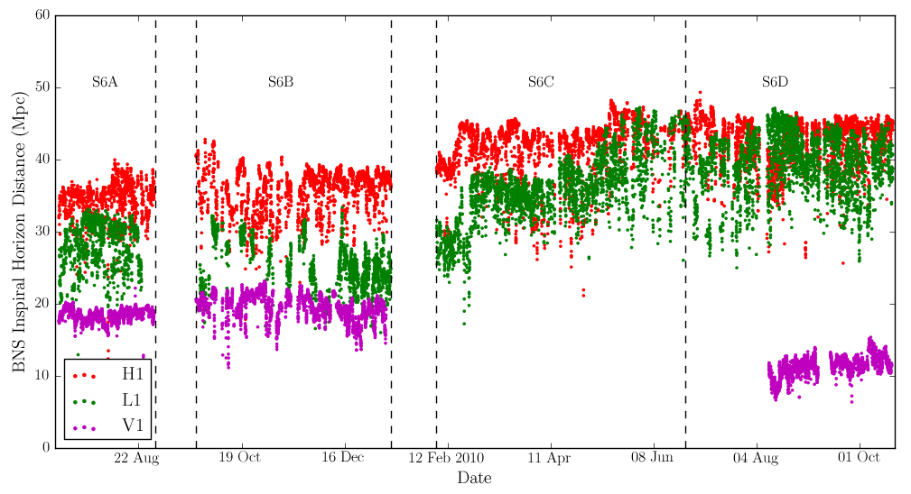
Sensitivity

Slide 50
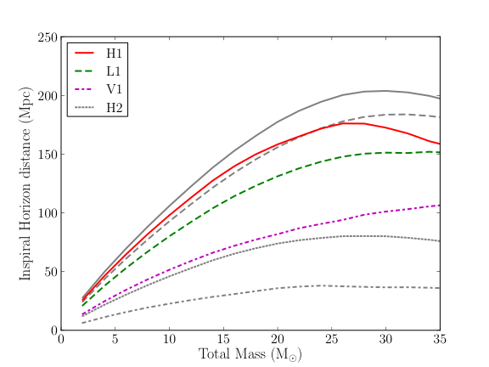
Sensitivity: S6A

Slide 51
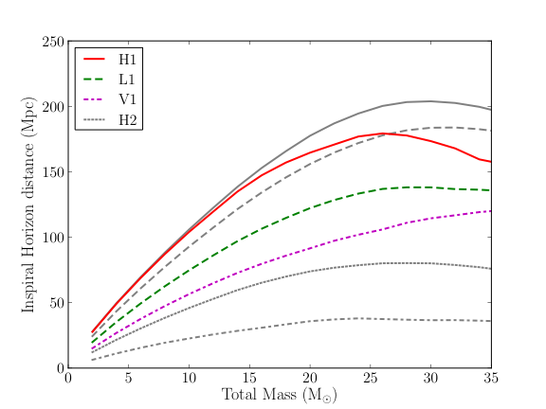
Sensitivity: S6B

Slide 52
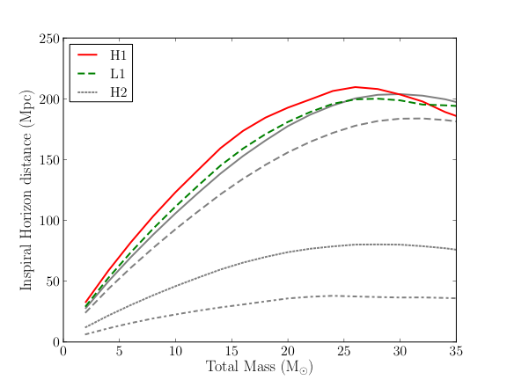
Sensitivity: S6C

Slide 53
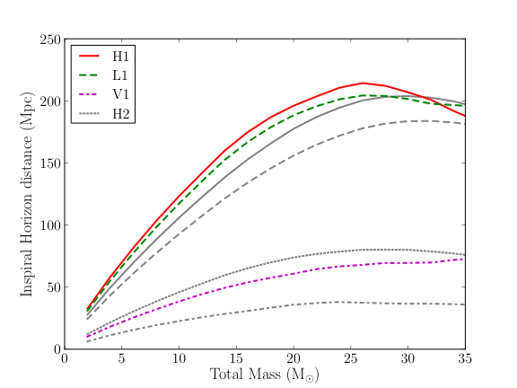
Sensitivity: S6D

Slide 54
Analyzed Time
Period | Live time* | Duty Cycle
S6A | 29.2 days | 0.53
S6B | 47.7 days | 0.44
S6C | 39.3 days | 0.28
S6D | 58.3 days | 0.50
Total | 174.5 days (0.48 years) | 0.41
*after final vetoes applied

Slide 55
Preliminary Results

Slide 56
Preliminary Results
We found a candidate GW event!

Slide 57
Preliminary Results
We found a candidate event!
16 September 2010 at 06:42:23 UTC
Event was louder than all background in standard analysis
With 100 time-slides, got FAR < 1 in 23 years
Not small enough to claim detection
To estimate FAR, performed as many 5s slides as possible in S6D
Resulted in ~4 million slides

Slide 58
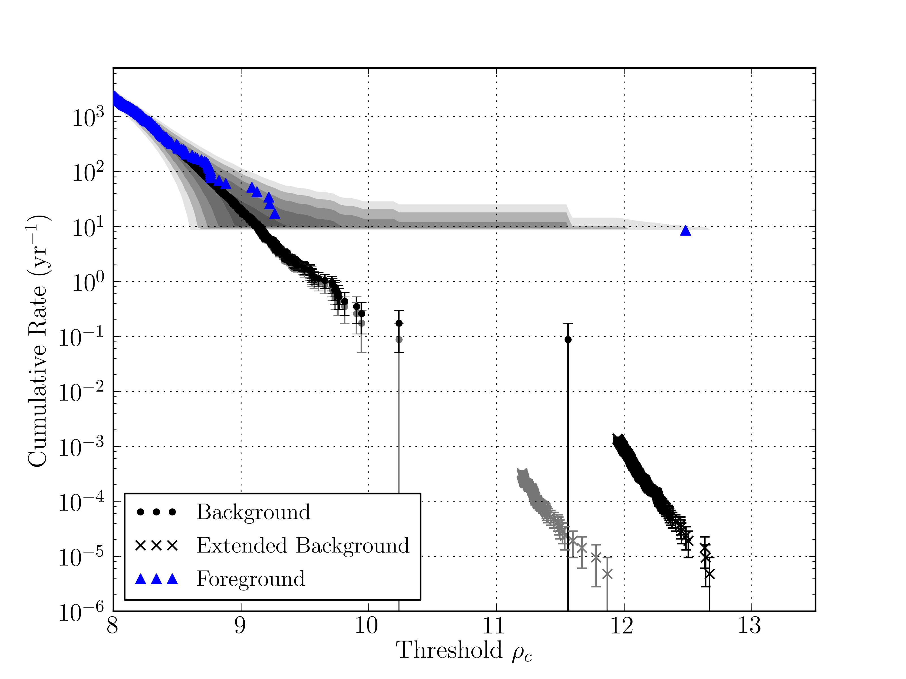
Preliminary Results

Slide 59
Preliminary Results
Obtained FAR of 1 in 40,000 years
FAR small enough to claim detection
Event was vetted by data quality investigations
No environmental causes could be found
We wrote a draft detection paper, for publication in PRL

Slide 60
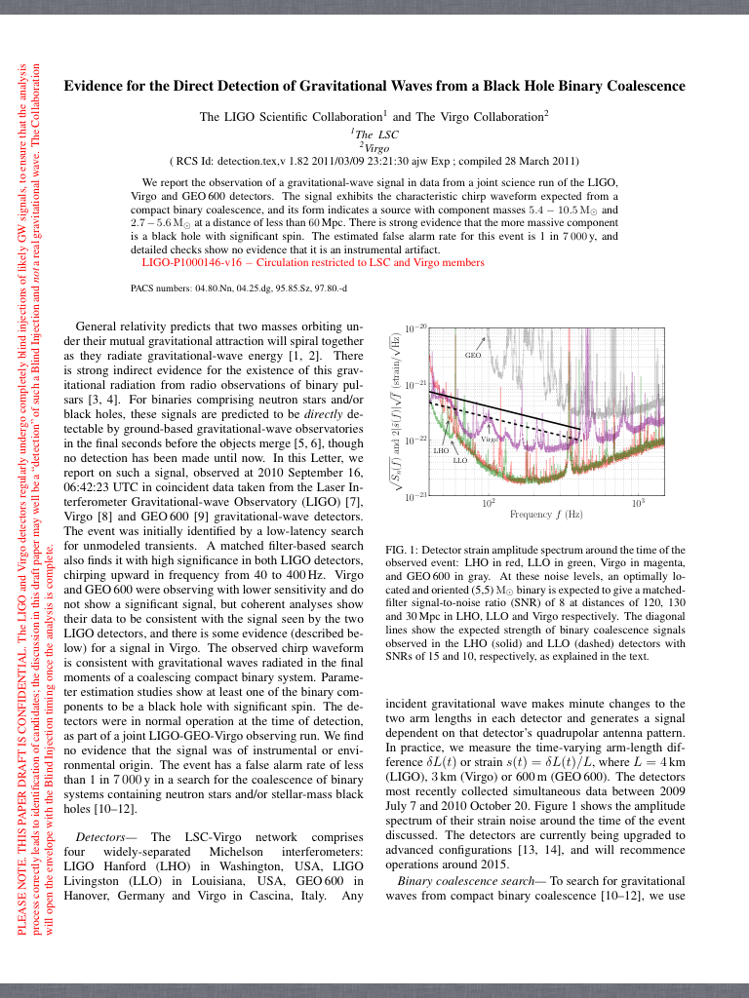
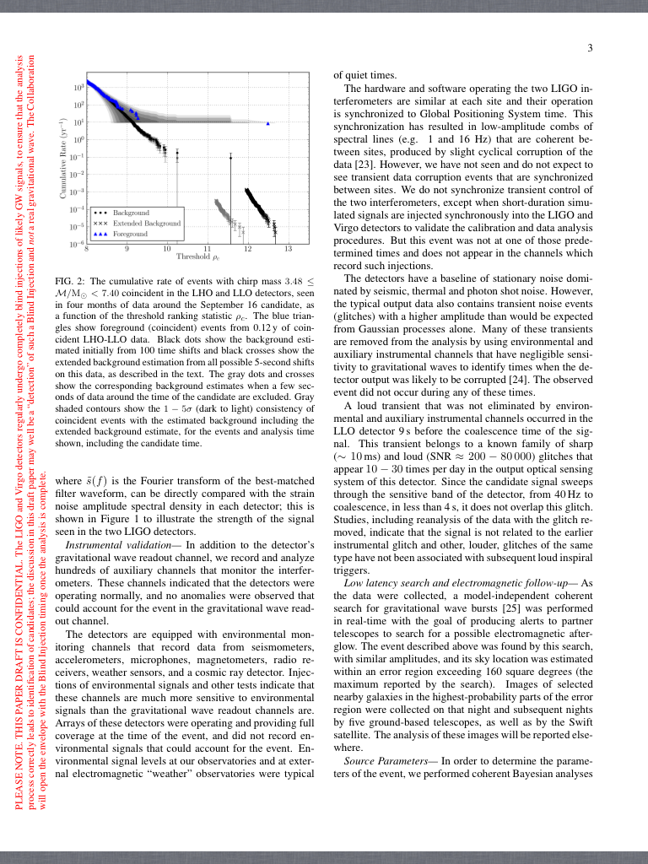
Preliminary Results

Slide 61
S6 Blind Injection
It was not a real event

Slide 62
S6 Blind Injection
It was not a real event
Hardware injection performed without search groups’ knowledge
Part of “blind injection challenge”
Only after a draft publication written was it revealed to be an injection
Purpose was to test our ability to detect

Slide 63
S6 Blind Injection
Blind injection challenge considered a success
Highlighted strengths and weaknesses of pipeline
Removed from data after revealed

Slide 64
Preliminary Results
No gravitational-wave candidates detected
Most significant event has a false alarm rate of 2.2 per year
This is consistent with background
Searched for ~0.5 years, expect an event with FAR ~2 per year
Upper limits currently being calculated
Publication expected shortly

Slide 65
Looking Forward

Slide 66
Advanced LIGO
Advanced LIGO currently being built
Expected to have a factor of 10 better sensitivity; results in factor of 1000 increase in volume
J. Abadie et al. Class. Quantum Grav.27:173001, 2010.

Slide 67
Advanced LIGO
Expected detection rates
Source
BNS | 0.4 | 40 | 400
NSBH | 0.2 | 10 | 1000
BBH | 0.4 | 20 | 1000
J. Abadie et al. Class. Quantum Grav.27:173001, 2010.

Slide 68
Conclusions
We have searched ~1.5 years of data at initial LIGO design sensitivity
We have not detected any gravitational waves
Our pipeline and analysis techniques have matured across S5 and S6
Will further develop before Advanced LIGO
Using these methods, we expect to detect GWs from CBCs in Advanced LIGO

Slide 69
Thank you!

Slide 70
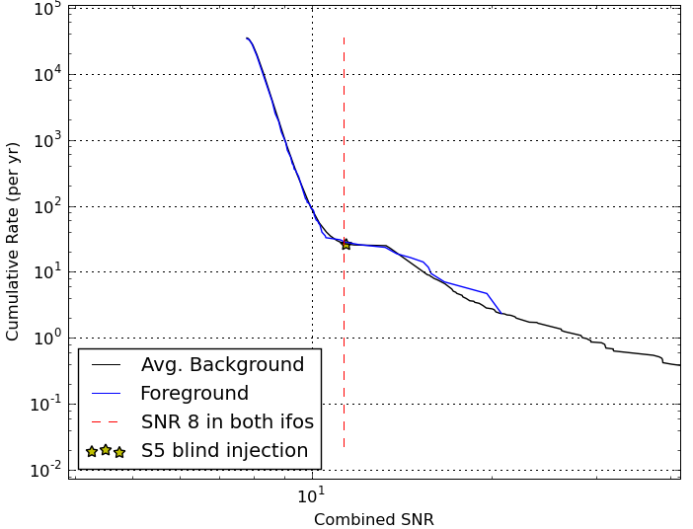
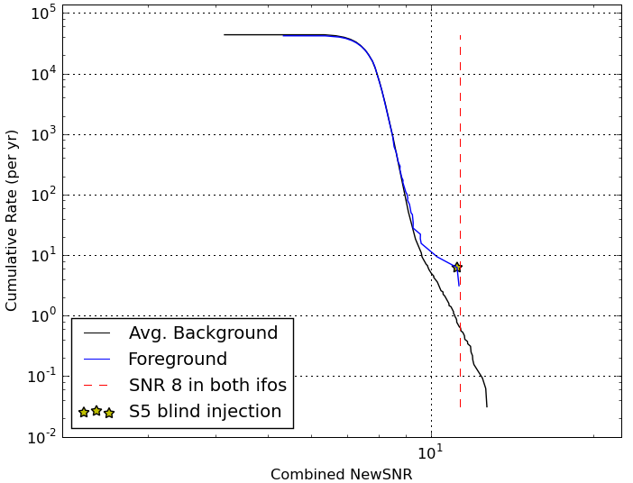
Extras: New SNR and DQ
Detecting at SNR 8 requires a well-tuned detection statistic, and extensive data quality investigations

Slide 71
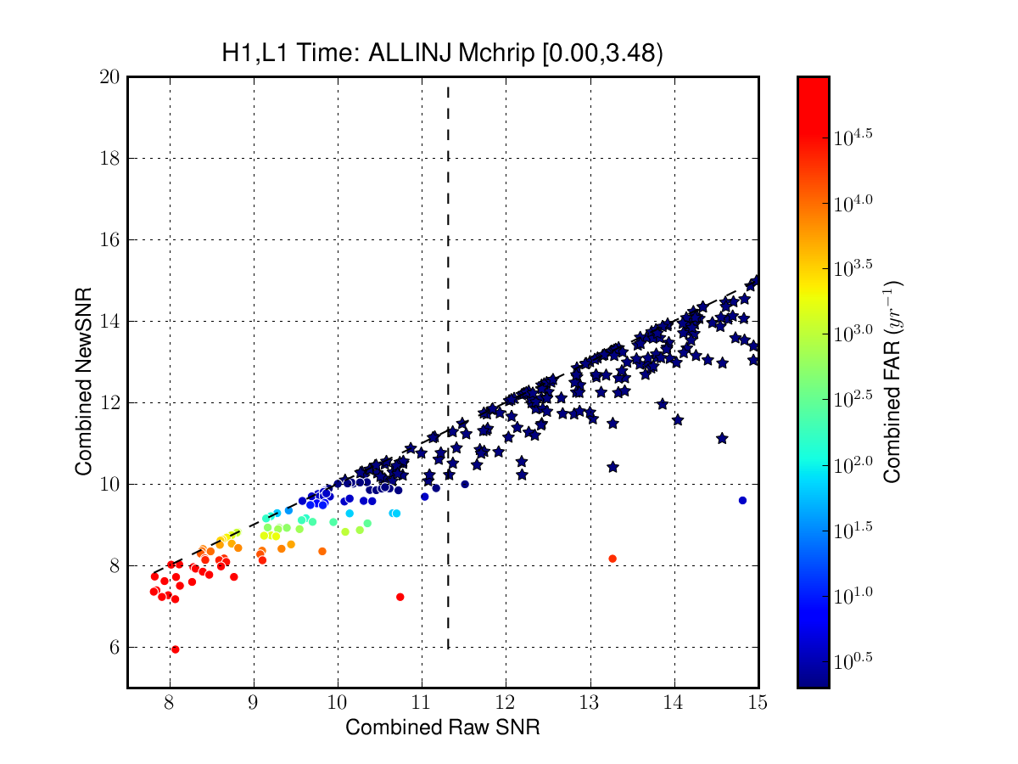
Extras: New SNR vs. SNR
Plot of low-mass (M_{chirp} < 3.48) injections in two weeks of S6C
Stars are injections louder than all background
Vertical dashed line represents SNR 8 in each detector

Slide 72
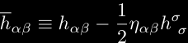
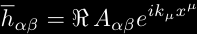
Extras: Physics of GWs
In the weak field limit:
Einstein field equations simplify to:
where:
In vacuum, this has the solution:
This can be simplified in the “TT” gauge to:

Slide 73
Template Bank
NSBH
BBH
BNS

